Slide 1
İş süreçlerİ ve Bİlgİ Sİstemlerİ
Yönetim Bilişim Sistemi
KONU – 2
Business Processes
and
Information Systems

Slide 2
İş süreçleri ve Bilgi Sistemleri
İş süreçleri
Bilgi sistemi türleri
İşbirliği ve sosyal ilişkiler
İş alanında bilgi sisteminin işlevi

Slide 3
Management Information System
What are business processes?
How are they related to information systems?
BUSINESS PROCESSES AND INFORMATION SYSTEMS
Business Processes
How Information Technology Improves Business
Processes- Information Systems

Slide 4
İş süreçleri- Business Processes
Business organization consisting of three princible level and each level have diffrent needs for performing its business processes chain. MIS Information System use different sub Information Systems to provide activity need of principle level.
3
2
1
1
What is the role of the major business processes on informatoin systems ?.
Business processes:
Workflows of material, information, knowledge
Sets of activities, steps
May be tied to functional area or be cross-functional
Businesses: Can be seen as collection of business processes.
Every business can be seen as a collection of business processes, some of which are part of larger encompassing processes.

Slide 5
remember the definishin: BUSINESS PROCESSES-1
Business processes, which we introduced in Chapter 1, refer to the manner in which work is organized, coordinated, and focused to produce a valuable product or service.
Business processes are the collection of activities required to produce a product or service.
These activities are supported by flows of material, information, and knowledge among the participants in business processes.
Business processes also refer to the unique ways in which organizations coordinate work, information, and knowledge, and the ways in which management chooses to coordinate work.

Slide 6
How Information Technology Improves Business Process
New technology can actually change the flow of information, making it possible for many more people to access and share information, replacing sequential steps with tasks that can be performed simultaneously, and eliminating delays in decision making.
New information technology frequently changes the way a business works and supports entirely new business models

Slide 7
business process-2
A business process or business method is a collection of related, structured activities or tasks that produce a specific service or product (serve a particular goal) for a particular customer or customers.
It can often be visualized with a flowchart as a sequence of activities with interleaving decision points or with a Process Matrix as a sequence of activities with relevance rules based on data in the process.

Slide 8
types of business processes
There are three types of business processes:
Management processes, the processes that govern the operation of a system. Typical management processes include "corporate governance" and "strategic management".
Operational processes, processes that constitute the core business and create the primary value stream. For example, taking orders from customers, and opening an account in a bank branch.
Supporting processes, which support the core processes. Examples include accounting, recruitment, call center,technical support.

Slide 9
EXAMPLES OF FUNCTIONAL BUSINESS PROCESSES on MIS
FUNCTIONAL AREA BUSINESS PROCESS
Manufacturing and production: Assembling the product, Checking for quality, Producing bills of materials
Sales and marketing : Identifying customers, making customers aware of the product, selling the product
Finance and accounting :Paying creditors, creating financial statements, Managing cash accounts
Human resources: Hiring employees, evaluating employees’ job performance, enrolling employees in benefits plans.

Slide 10
EXAMPLES OF FUNCTIONAL BUSINESS PROCESSES on MIS
İŞLETİMSEL DÜZEY: Tutanak İşleme : İşletimsel Bilgi Alt-Sistemleri
Satış/
Pazarlama
İmalat/
Üretim
Maliye
Muhasebe
İnsan
Kaynakları
Sipariş
izleme
Makine
denetimi
Emanet
Alış/veriş
Maaş
Tazminatlar
Fabrika-iş
planı
Para
Hareketleri
Ödemeler
Eğitim
Sipariş
işleme
Alacaklar
Çalışan
tutanakları
Malzeme
Hareketi

Slide 11
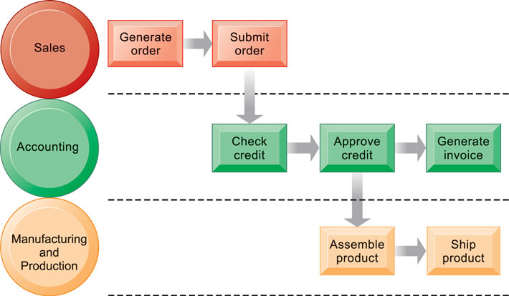
Example: THE order fulfillment PROCESS
Sipariş hazırlama iş süreci: Hazırlama-> sunma->onaylama-> faturalama->paketleme-> gönderme
Fulfilling a customer order involves a complex set of steps that requires the close coordination of the sales, accounting, and manufacturing functions.

Slide 12
İnsan Kaynakları: Bir Örnek: Bilgi Sistemi -iş süreçleri Standart bir uygulaması Personel Tutanakları BS
Aylık
bordro
Birimlerden personel bilgileri
Veri tutanağı
sicil No, İşten ayrılanlar Raporu 14. Ekim. 2014
Adı Soyadı Tarih Adı Soyadı sicil no Ayrılış nedeni
Adresi 11/11/06 Ahmet Biçer 5678 görev kaldırıldı
Bölümü/Birimi 24/12/06 Ali Kalır 345 Yaş sınırı
Doğum Tarihi 22/12/06 Ayşe Bal 8765 İsteği ile
Evlilk durumu 30/12/06 Şelim Gemici 6754 Başarısızlık
Cinsiyeti
Aylık ücreti
Eğitimi
Ünvanı
İşe başlama tarihi
İşten ayrılma tarihi
Ayrılma nedeni
......
Personel Ana
Veri tabanı
İnsan Kaynakları
Bilgi Sistemi
Yönetici
Raporları
Çevrim-İçi
Sorgulama

Slide 13
Üretim/imalat: Bir Örnek Standart Uygulama: iş süreçleri Malzeme Stok Denetimi BT
Yükleme ve istek verisi
Veri tutanağı
Parça No, Stok Durum Raporu- 14.Ekim 14
Açıklama Parça no Açıklama Eldeki Sipariş deki
Eldeki miktar 6543 Fan 1235 600
Sipariş deki miktar 4321 K.Kayışı 5570 800
Tekrar Sipariş sayısı 8808 K.Boya 943 0
...... .................
Stok Denetimi
Bilgi Sistemi
Stok Ana
Veri tabanı
Yönetici
Raporları
Çevrim-İçi
Sorgulama

Slide 14
Management Information System
How do systems that link the enterprise improve organizational performance?
TYPES OF INFORMATION SYSTEMS
Systems for Different Management Groups
Systems for Linking the Enterprise
E-business, E-commerce, and E-government

Slide 15
how information systems support the business processes of a firm ?
1-What are the main tools of IS: input/output and storage hardware models and Application Software which supports entirely new business processes models which defined in new MIS Information System.
2-Application software is a set of programs designed to carry out operations for a specific application. Application package software, or simply an application package, is a collection of software programs that have been developed for the purpose of being licensed to third-party organizations. Application packages are generally designed to support commonly performed business functions.
3- MIS Information System , includes number of Aplication Software packages which supports management and operation business processes . For example : On input and storage operations of hole system they use ON LINE TRANSACTION PROCESSING Software Package or DECISION SUPPORT SYSTEMS Software Package support managers and other decision makers.

Slide 16
CHAPTER 2: GLOBAL E-BUSINESS AND COLLABORATION information system may transform business to new more efficient processes
Information technology enhances business processes in two main ways:
Increasing efficiency of existing processes
Automating steps that were manual
Enabling entirely new processes that are capable of transforming the businesses
Change flow of information
Replace sequential steps with parallel steps
Eliminate delays in decision making

Slide 17
Perspectives on Information Systems: Dimentions: Organizational, Manageral and Technological
Organizational dimension of information systems
Hierarchy of authority, responsibility
Management dimension of information systems
Managers set organizational strategy for responding to business challenges
In addition, managers must act creatively:
Technology dimension of information systems
Computer hardware and software
Data management technology
Networking and telecommunications technology

Slide 18
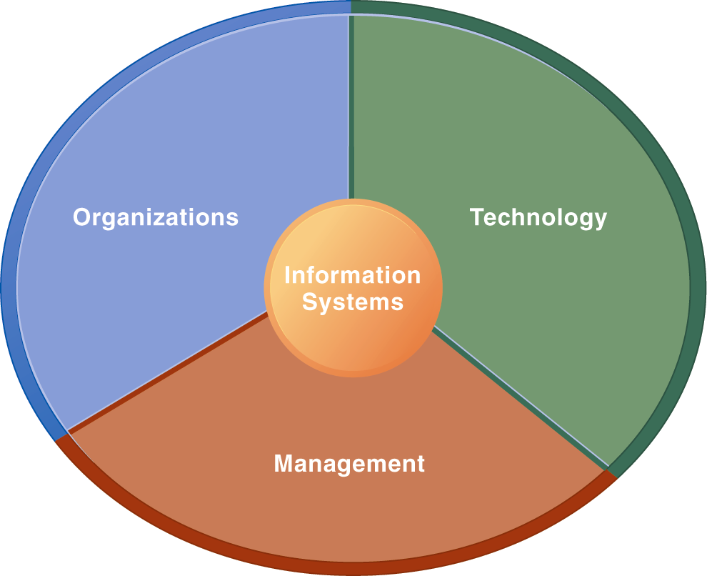
Information Systems Are More Than Computers includes managrial, organizational and technical dimentions of the system
Using information systems effectively requires an understanding of the organization, management, and information technology shaping the systems. An information system creates value for the firm as an organizational and management solution to challenges posed by the environment.

Slide 19
Managerial Levels in a Firm
Business organizations are hierarchies consisting of three principal levels: senior management, middle management, and operational management. Information systems serve each of these levels. Scientists and knowledge workers often work with middle management.

Slide 20
MAJOR TYPES OF SYSTEMS IN ORGANIZATIONS
Different Kinds of Systems
Three main categories of information systems serve
different organizational levels:
1. Operational-level systems: support, operational managers, keeping track of the elementary activities and transactions
2. Management-level: systems, serve the monitoring,
controlling, decision-making, and administrative
activities
3. Strategic-level systems: help senior
management tackle and address strategic issues

Slide 21
Bilgi sistemi işlevsel Düzeyleri
Bilgi Sistemlerinin işlevsel Dağılımı:
Üç Ana alt Düzey Sistem:
1-Temsel düzey,→ İşletim Yöneticileri
2-Yönetsel düzey,→ Orta Yöneticiler
3-Stratejik Düzey, → Üst Yöneticiler
. Alt düzey Çalışanları ve Görevleri:
1- Temsel düzey,→ İşletim Yöneticileri- İşlem gerçekleştirenler- çalışanlar
2-Yönetsel düzey,→ Orta Yöneticiler-Denetleyici,karar verici ve planlayıcılar
3-Stratejik Düzey, → Üst Yöneticiler-Stratejik karar vericiler

Slide 22
how information systems support the business processes of a firm ?
Now, what you understand business processes, it is time to look more closely at how information systems support the business processes of a firm:
Because there are different interests, specialties, and levels in an organization, there are different kinds of systems. No single system can provide all the information an organization needs.
A typical business organization has systems supporting processes for each of the major business functions—systems for sales and marketing, manufacturing and production, finance and accounting, and human resources etc.
Functional systems that operate independently of each other are becoming a thing of the past because they cannot easily share information to support cross-functional business processes.
Many have been replaced with large-scale cross-functional systems that integrate the activities of related business processes and organizational units.

Slide 23
Information Technology transforms the bussines processes
Business processes can extented to strategical, economical, efficient and serviceble lnformation Systems on the organizational levels of the company.
Or, major bussiness functions of the organization are being replaced to functional Information Systems that integrate the activities of related business processess.
New Information Technologies can exactly change the flow of information, to access and shair iformation and elminate delays to decision making etc.
Let study the major Information Systems !!

Slide 24
How system serve different management groups? “Types of Business Information Systems”
Different Application Software Packages (Information Systems) are support entirely all activities through the Management Information System, that we represented on Hierarchic Management chart.
Group One : may includ three main Information Systems which support MIS main activities:
1- Transaction processing systems (TPS), Systems serving operational management are such as payroll or order processing, that track the flow of the daily routine transactions necessary to conduct business.
2-Management information systems (MIS), produce reports serving middle management by condensing information from TPS, and these are not highly analytical.
3- Decision-support systems (DSS), support management decisions that are unique and rapidly changing using advanced analytical models.
4-Executive suppot system(ESS), support senior management by providing data often formed as graphics and charts via portals and dashboarts.

Slide 25
SYSTEMS FOR DIFFERENT MANAGEMENT GROUPS
A business firm has information systems to support different groups or levels of management.
These systems include:
1- transaction processing systems,
2-managementinformation systems, 3-decision-support systems,

Slide 26
Management Information Systems
Chapter 2 Global E-Business: How Businesses Use Information Systems
Types of Business Information Systems
Relationship of systems to one another
TPS: Major source of data for other systems
ESS: Recipient of data from lower-level systems
Data may be exchanged between systems
In reality, most businesses’ systems only loosely integrated
Notes:
This slide once again emphasizes the relationship between different types of systems, but explain that actually achieving such a high level of integration is rare. You could ask students to offer reasons why it might be difficult to do this.

Slide 27
Alt Sistemler arasında İlişki: Bilgi Alt-Sistemleri Birbirlerini aşağıdan yukarıya besler ve iki yönlü ilişkilidir
Alt Sistem Döngüsü:
Üst-Yönetici
Destek Sistemi
Karar Destek
Alt-Sistemi
Yönetim Bilgi
Sistemi
Tutanak
İşleme Alt-Sistemi

Slide 28
- Transaction processing systems (TPS)
Main INFORMATİON SYSTEMS
On
Managerial Levels in a Firm
-Executive suppot system(ESS),
-Management information systems (MIS) Decision-support systems (DSS)

Slide 29
“Types of Business Information Systems” Transaction processing systems Serve Operational Level
Transaction processing systems-(TPS)
Perform and record daily routine transactions necessary to conduct business
Examples: sales order entry, payroll, shipping
Allow managers to monitor status of operations and relations with external environment
Serve operational levels
Serve predefined, structured goals and decision making

Slide 30
Transaction processing systems (*) (Tutanak İşleme Alt Sistemi)
Perform and record daily routine transactions necessary to conduct business
Examples: sales order entry, payroll, shipping
Allow managers to monitor status of operations and relations with external environment
Serve operational levels
Serve predefined, structured goals and decision making
(*) On-Line Transaction Processing System-OLAP Çevrim içi Tutanak İşleme Sistemi

Slide 31
Çevrim-içi Tutanak Alt-Sistemi-1
Tüm girdi işlemlerini kapsayan- Çok amaçlı bir alt sistemdir
Tutanak İşleme Alt Sistemi’nin bilişimsel temel işlevi Veri-yakalama (Data-Capturing), Veri-biriktirme (Data Storing) ve Veri-güncelleme (Data Updating) ile işlevsel birimlerin tutanak uygulama işlemlerini sürdürmek ve güncel rapor türetmektir.
TIS- Tutanak İşleme Sistemi
(OLTP-Transaction Processing System)
işleme
Veri Yakalama
Veri Saklama-
Biriktirme/Günleme
Temel veri/bilgi
besleme

Slide 32
Veri Yakalama Toplama “Data Capturing /Acqusition”-2
Çevrim İçi Tutanak İşleme Sisteminin bir bölümü veri yakalama sistemleridir:
Veri toplamada veri girişine hız ve kolaylık kazandıran donanım ve bu donanıma özgü yazılımlar kullanılır.
Günümüzde, kablosuz iletişim ve Internet teknolojileri, verinin çevri-içi ve gerçek zamanlı sistemleri uygulamada veri girişini sağlar.
Veri toplama verinin tanımlanması ya da algılanması, sisteme girmesi ya da özdevimli algılayıcılarla yakalanması, verinin denetlenmesi, ön işlemlerin yerine getirilmesi gibi işlevlerin tamamını kapsar.

Slide 33
Çevrim-İçi Tutanak İşleme Sistemi-3
ÇTİS Dört temel işlevi kapsar:
1- Veri girişi(Data Entry) Bağlı kaynaklardan veri girişini sağlar,
2- Veritabanı Güncelleme (Data Base Maintanence) Veritabanlarının günleme işlemleri
3- Doküman ve Rapor Oluşturma (Documand and Report Generetion) işletim basamaklarına günlük iş ve denetim rapoları türetir,
Önemli bir Görevi: Çevrim İçi Analitik İşleme (OLAP) Karar destek sistemine girdi oluşturur.

Slide 34
- Çevrim İçi Tutanak İşleme Sistemi-4 (On Line Transaction Processing - OLTP)
İşletimsel düzeyde; kurumsal iş süreçlerine ilişkin hergün işlenen(*) tutanakların alınmasına, tutanaklar üzerinde temel işlemlerin gerçekleştirilmesini ve gerekli tutanakların saklanmasını/biriktirilmesini /güncellenmesini sağlayan, bilgisayara dayalı alt sistemdir.
Aynı zamanda Yönetim Bilgi Sistemine güncel bilgi kaynağı oluşturur.
Kurumsal sistemin tüm veri giriş işlemlerini yönetir.
(*) Şirketin/kuruluşun her gün yinelenen satış, satınalma, faturalama, sorgulama, istek, ödeme, muhasebeleşme, siparış, gibi işlerine ilişkin tutanakları….

Slide 35
OLTP-OnlineTransaction Processing System-5 main functions summary
Transaction processing systems
Perform and record daily routine transactions necessary to conduct business
Examples: sales order entry, payroll, shipping
Allow managers to monitor status of operations and relations with external environment
Serve operational levels
Serve predefined, structured goals and decision making

Slide 36
TIS- Tutanak İşleme Alt Sistemi : 6 Ek Görevler üstlenebilir Müşteriye açık işlem servisleri ( Customer Selfservice) kurabilir
Kurum/Şirket müşterilerle web üzerinden çevrim-içi bağlantı ile işlem yürütebilir. Bu servis, Tutanak İşleme Sistemi ile bağlantılı olarak tutanak işleme hizmeti yapar.
Böylece , Müşteriye açık işlem servisleri
(Customer Selfservice) Tutanak İşleme Alt Sisteminin bir parçası olarak işler.
Örneğin Çevrim-içi bankacılık ve Kullanıcı Giriş-Makineleri (ATM) servisleri tutanak işleme sağlayan servis yapılarına örnek verilebilir.
müşteriler
Tutanak
İşlem
Veritabanı
Yönetim
Yazılımı
Müşteri Servisi:
Satış sonrası hizmetler,
Muhasebe
Ulaştırma-Teslim
Muhasebe
Satış/teslim

Slide 37
“ Types of Business Information Systems” Management Information System which serve to middle management
The term MIS also used a specific category of information systems which serving middle management level.
MIS mainly summarize and report on the company’s basic operatipons using data supplied by transction processing system.
So not confiuse “title” MIS and Management information Systems !

Slide 38
Management information systems
We define management information systems as the study of information systems in business and management.
The term management information systems (MIS) also designates a specific category of information systems serving middle management.
MIS provide middle managers with reports on the organization’s current performance. This information is used to monitor and control the business and predict future performance.
MIS summarize and report on the company’s basic operations using data supplied by transaction processing systems.
The basic transaction data from TPS are compressed and usually presented in reports that are produced on a regular schedule. Today, many of these reports are delivered online.

Slide 39
- Yönetim Bilgi Alt-Sistemi Management Information System-4
It is at the management level of an organization that serve the functions of;
Planing, controlling, and decision making by
Prividing routine reports. Summarize and report
On the enterprise basic operations.
The basic transactions from TPS are composed and are
usually presented as long reports.
Most MIS use mathematical and statistical techniques and
have flexible and little analytical capabity

Slide 40
Yönetim Bilgi Alt-Sistemi
Yönetim Bilgi Alt-Sistemi’nin temel işlevi tutanak alt
sisteminde yürütülen uygulama işlevlerinin denetimi,
kontrolu ve bu amaçla gerekli raporları türetmektir.
Management level operations:
Inputs: High volume transaction level data
Processing: Simple models
Outputs: Summary reports
Users: Middle managers
Example: “Annual budgeting”

Slide 41
MIS-Chapter 2 Global E-Business: How Businesses Use Information Systems
Management information systems
Summarise and report on the company’s basic operations. Serve the management level with reports and online access facilities
In addition the operations of MİS:
Serve middle management
Provide reports on firm’s current performance, based on data from TPS
Provide answers to routine questions with predefined procedure for answering them
Typically have little analytic capability

Slide 42
Management information systems
In addition the operations of MİS:
Serve annually operational management
Provide reports on firm’s current performance, based on data from TPS
Provide answers to routine questions with predefined procedure for answering them
Typically have little analytic capability

Slide 43
Yönetim Bilişim sistemi Gerekli Veriyi Tutanak işleme Sisteminden Nasıl Alıyor ? YBS +TIS İlişkisi
Tutanak işleme sistemi Yönetim Bilişim sistemi
TPS supply summarized transaction data to the MIS reporting system at the end
of the time period. Managers gain access to the organizational data through the
MIS, which provides them with the appropriate reports.

Slide 44
Management Information System
Management information system that serv to middle management by generating routing reporting systems .
Other type of business inteligence system support non routine decision making by special Decision Support System (DSS) this information system servs to middle management

Slide 45
“Types of Business Information Systems” Decision support systems serv middle management
Decision support systems
Serve middle management
Support non-routine decision making
uses advanced analytical models
Example: What is impact on production schedule if December sales doubled?
Often use external information as well from TPS and MIS
Model driven DSS
Voyage-estimating systems
Data driven DSS
Marketing analysis systems

Slide 46
Special Decision Support Systems
Systems for business intelligence (bi) covers data and software tools for organizing, analyzing and prıviding access to help managers or other enterprise users make more efficiebt decisions.
Enterprise Systems may develope three level of decision support systems:
Decision support systems (DSS)
Executive support systems (ESS)
Knowledge management systems (KMS)

Slide 47
Decision support systems to Middle Management
Decision support systems
Serve middle management
Support non-routine decision making
Example: What is impact on production schedule if December sales doubled?
Often use external information as well from TPS and MIS
Model driven DSS
Voyage-estimating systems
Data driven DSS
Intrawest’s marketing analysis systems
Example- DDS may support Voyage Estimate Decsion-Support System.“what wouldbe the impact on prduction schedual if we were to doupble sales in the month of december”?
Example- DDS may support Voyage Estimate Decsion-Support System. “What is the optimal speed at which a particular vessel can optimize its profit and still meet its delivery schedual?

Slide 48
Management is essentially a decision-making process
Decision making is the process by which a choice is madebetween several courses of action.
In other words, it is the process which results in a commitment to a course of action.. As we shall see, this decision making process includes stages such as gathering information and identifying possible options as well as actually determining what action should be taken.
One of the organizational roles of a manager is that of decision maker. In this role, the manager analyzes information to make informed decisions.

Slide 49
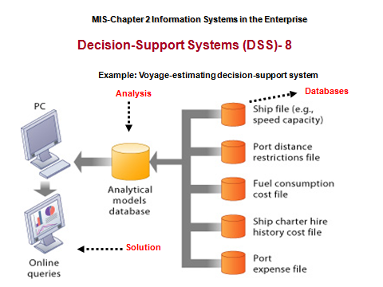
Yöneticiler, Karar alma ve Bilgi Sistemi- Decision-Support Systems (DSS)
Alışılagelmiş yönetim modeli,planlama, düzenleme,
eşgüdüm, karar alma ve denetim görevleri ile
yükümlüdür.
Karar almaya destek sağlayan bilgi Sistemi;
İşlemsel, yönetsel ve stratejik karar alma süreçlerini
destekleyen bilgi türetmeyi sağlayan bilgi alt-
sistemlerini içerir.
Bu amaçla: Karar Destek Bilgi Sistemi “Decision-
Support Systems (DSS)” Kurulmuştur.

Slide 50
Business intelligence(BI) help users to make better business decisions
Business intelligence
Class of software applications
Analyze current and historical data to find patterns and trends and aid decision-making
Used in systems that support middle and senior management
Data-driven DSS
Executive support systems (ESS)

Slide 51
Business Intelligence – İş Zekası
Application and technenolgies to help users make better decisions.
Includes data end software tools for organizing, analysing and providing access to data to help managers and other users make more informed decisions.
Executive Support Systems-ESS uses Business Intelligent tools and software and also present interfaces to senior managers- portal and Digital dashboards to display screen graphs and charts ....

Slide 52
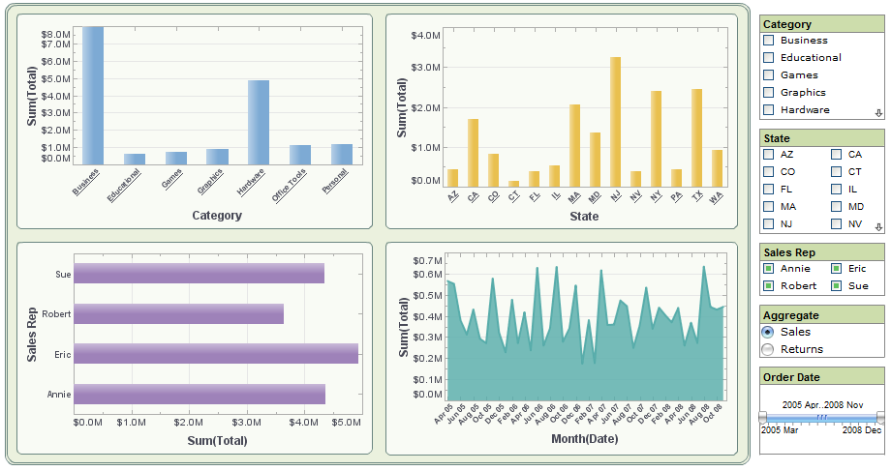
Executive Support System DASHBOARD: In management information systems a dashboard is "an easy to read, often single page, real-time user interface, showing a graphical presentation of the current status (snapshot) and historical trends of an organization’s key performance indicators to enable instantaneous and informed decisions to be made at a glance A Sales Dashboard Example

Slide 53
CHAPTER 2: GLOBAL E-BUSINESS AND COLLABORATION
Types of Information Systems
Business intelligence
Class of software applications
Analyze current and historical data to find patterns and trends and aid decision-making
Used in systems that support middle and senior management
Data-driven DSS
Executive support systems (ESS)

Slide 54
İş-Zekası (Business Intelligence-BI)
Business intelligence software and applications includes a range of tools. Some BI applications are used to analyze performance, projects, or internal operations, such as
SQL - Associative Query Logic; Scorecarding; Business activity monitoring; Business Performance Management
Performance Measurement; Business Planning; Business Process Re-engineering; Competitive Analysis;
User/End-user Query and Reporting;Enterprise Management systems; Executive Information Systems (EIS);
Supply Chain Management/Demand Chain Management; and Finance and Budgeting tools.

Slide 55
İş-Zekası (Business Intelligence-BI)
Other BI applications are used to store and analyze data, such as Data mining (DM), Data Farming, and Data warehouses;Decision Support Systems (DSS) and Forecasting; Document warehouses and Document Management;Knowledge Management; Mapping, Information visualization, and Dashboarding;
Management Information Systems (MIS);Geographic Information Systems (GIS); Trend Analysis; Software as a service (SaaS)
Business Intelligence offerings (On Demand)- similar to traditional BI solutions but software is hosted for customers by a provider.

Slide 56
Üst-Bilgi yönetimi Alt Sistemi- “Knowladge Management System” İş-Zekası (Business Intelligence-BI)
1] ;Online Analytical Processing (OLAP) and multidimensional analysis; sometimes called "Analytics" (based on the "hypercube" or "cube");
Real time business intelligence;Statistics and Technical Data Analysis; Web Mining, Text mining and Systems intelligence.
Other BI applications are used to analyze or manage the "human" side of businesses, such as Customer Relationship Management (CRM) and Marketing tools and Human Resources applications.Web Personalization
For examples of implemented Business Intelligence systems, see the BI screenshot collection at The Dashboard Spy.

Slide 57
İş-Zekası (Business Intelligence-BI)
In 1989 Howard Dresner, a Research Fellow at Gartner Group popularized "BI" as an umbrella term to describe a set of concepts and methods to improve business decision-making by using fact-based support systems. Dresner left Gartner in 2005 and joined Hyperion Solutions as its Chief Strategy Officer.

Slide 58
“Types of Business Information” Executive support systems serv senior managers
Executive support systems
Support senior management
Address non-routine decisions
Requiring judgment, evaluation, and insight
Incorporate data about external events (e.g. new tax laws or competitors) as well as summarized information from internal MIS and DSS
Example: Digital dashboard with real-time view of firm’s financial performance: working capital, accounts receivable, accounts payable, cash flow, and inventory

Slide 59
CHAPTER 2: GLOBAL E-BUSINESS AND COLLABORATION
Types of Information Systems – Senior Management
Executive support systems (ESS)
Support senior management
Address non-routine decisions
Requiring judgment, evaluation, and insight
Incorporate data about external events (e.g. new tax laws or competitors) as well as summarized information from internal MIS and DSS
Example: Digital dashboard with real-time view of firm’s financial performance: working capital, accounts receivable, accounts payable, cash flow, and inventory

Slide 60
Executive support systems (ESS)
Executive support systems (ESS) help senior management make these decisions. They address non-routine decisions requiring judgment, evaluation, and insight because there is no agreed-on procedure for arriving at a solution.
ESS present graphs and data from many sources through an interface that is easy for senior managers to use.
Often the information is delivered to senior executives through a portal, which uses a Web interface to present integrated personalized business content.

Slide 61
Üst-Yönetici Karar Destek Sistemleri Executive Support Systems-ESS-1
Stratejik düzeyde yer alan bu sistem, yönetimin uzun vadeli kararlarını almada ileri teknikleri kullanarak yararlı bilgi türetmeyi amaçlar.
Analitik modelleri kurum dışı verileri de değerlendirmeye katar.
support the information and decision-making needs of senior executives by providing easy access to both internal and external information relevant to meeting the strategic goals of the organization. It is commonly considered as a specialized form of a Decision Support System (DSS)

Slide 62
MIS-Chapter 2 Information Systems in the Enterprise
EXECUTIVE SUPPORT SYSTEMS (ESS)-2:
System pools data from internal and external sources
The basic elements and management levels:
Inputs: Aggregate data ( küme veri)
Processing: Interactive (Etkileşimli)
Outputs: Projections (grafiksel)
Users: Senior managers (üst-yönetici)
Example: 5 year operating plan

Slide 63
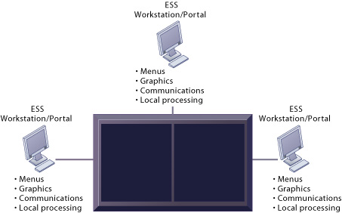
MIS-Chapter 2 Information Systems in the Enterprise
Model of a Typical Executive Support System System pools data from internal and externelsources and makes them available to executives in an easy-to-use
External data Internet news retrievals so on
Internal historical data TPS/MIS Finansal data Modellng/ analysis

Slide 64
Relationship of systems to one another
Relationship of systems to one another
TPS: Major source of data for other systems
ESS: Recipient of data from lower-level systems
Data may be exchanged between systems
In reality, most businesses’ systems are only loosely integrated (but they are getting better!)

Slide 65
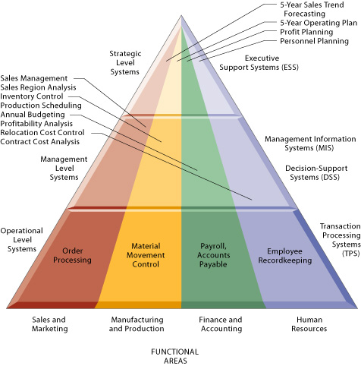
The Four Major Types of Information Systems
And Main Business Processing Functions/Tasks

Slide 66
CHAPTER 2: GLOBAL E-BUSINESS AND COLLABORATION
Types of Information Systems
Relationship of systems to one another
TPS: Major source of data for other systems
ESS: Recipient of data from lower-level systems
Data may be exchanged between systems
In reality, most businesses’ systems are only loosely integrated (but they are getting better!)

Slide 67
Global Information System may include Office Information Systems (OIS) Office Information Systems are concerned with getting all relevant information to all those who need it.
Office information systems support the wide range of business office activities that provide for improved work flow and communications between workers, regardless of whether or not those workers are physically located in an office.
Office information systems may use the following technologies:
Electronic forms technology
Work group technology
Electronic messaging technology
Office automation suite technology
Imaging technology

Slide 68
Ofis Bilgi Sistemi Alt Sistemi-2
Sistemin Genel içeriği
-Grup çalışması: iş alanı ortamında veri bilginin müşterek kullanılmasını ve hazırlanıp paylaşılmasını sağlayan yazılımdır. (Groupware)
- İş programı ve planlaması: Birimler arasında toplantı ve iş paylaşımı planlaması ve takvimlendirilmesini sağlayan yazılımdır. (Calender and scheduling software)
-Yazılı kaynağı elektronik ortama dönüştürüp düzenleme yazılımı:
(Document image processing)
-Elektronik Doküman Yönetim Sistemi Yazılımı: Sayısal ortamdaki dökümanın saklanması, erişilmesi, işlenmesi, yapılandırılması gibi ofis işlemlerini sağlar. (EDMS)
-İş akışı isleme Yönetim Sistemi yazılımı: Tanımlanmış iş uygulamaarının izlenmesini denetlenmesini, planlanmasını sağlar. (Workflow M S)

Slide 69
Enterprise applications
Enterprise Information Systems provide a technology platform that enables organizations to integrate and coordinate all their business processes. Then this approuch has add new IS’s to the structure of MIS managenent!
There are four major enterprise applications: enterprise systems(ES), supplychain management systems (SCM), customer relationship management systems (CRM), and knowledge management systems (KMS).

Slide 70
Teknoloji Evrimin Kurumsal Yapı Etkileşimi
80’li Yıllar
80’lerin Sonu
90’lı Yıllar
90’ların Sonu
2000
İlişkisel
Öncesi
İstemci/Sunumcu
İlişkisel
Kurumsal
İlişkisel
İlişkisel
Ötesi
İnternet
Veritabanı
E-iş
İnternet
Platformu
Veri-Merkezli
Uygulama
Platformu
Web
Uygulamaları
Veri
Ambarı &
OLTP
istemci/
Sunumcu
OLTP
Çevresel ilişki
Basit
OLTP, Anlık SQL

Slide 71
Kurumsal Sistem (chapter-2) Çoğu kez satıcı ve müşterileri de içine alır
Kurumsal sistem
Örgütsel sınır
S A T I C I L A R
üretim
Muhasebe
M Ü Ş T E R L E R
İŞ SÜREÇLERİ
İnsan
kaynakları
Satış ve
pazarlama
Maliye

Slide 72
enterprise applications
One solution is to implement enterprise applications, which are systems that span functional areas, focus on executing business processes across the business firm, and include all levels of management.
Enterprise applications help businesses become more flexible and productive by coordinating their business processes more closely and integrating groups of processes so they focus on efficient management of resources and customer service.
There are four major enterprise applications:
enterprise systems(ES),
supplychain management systems (SCM),
customer relationship management systems (CRM), and
knowledge management systems (KMS).
Each of these enterprise applications integrates a related set of functions and business processes to enhance the performance of the organization as a whole

Slide 73
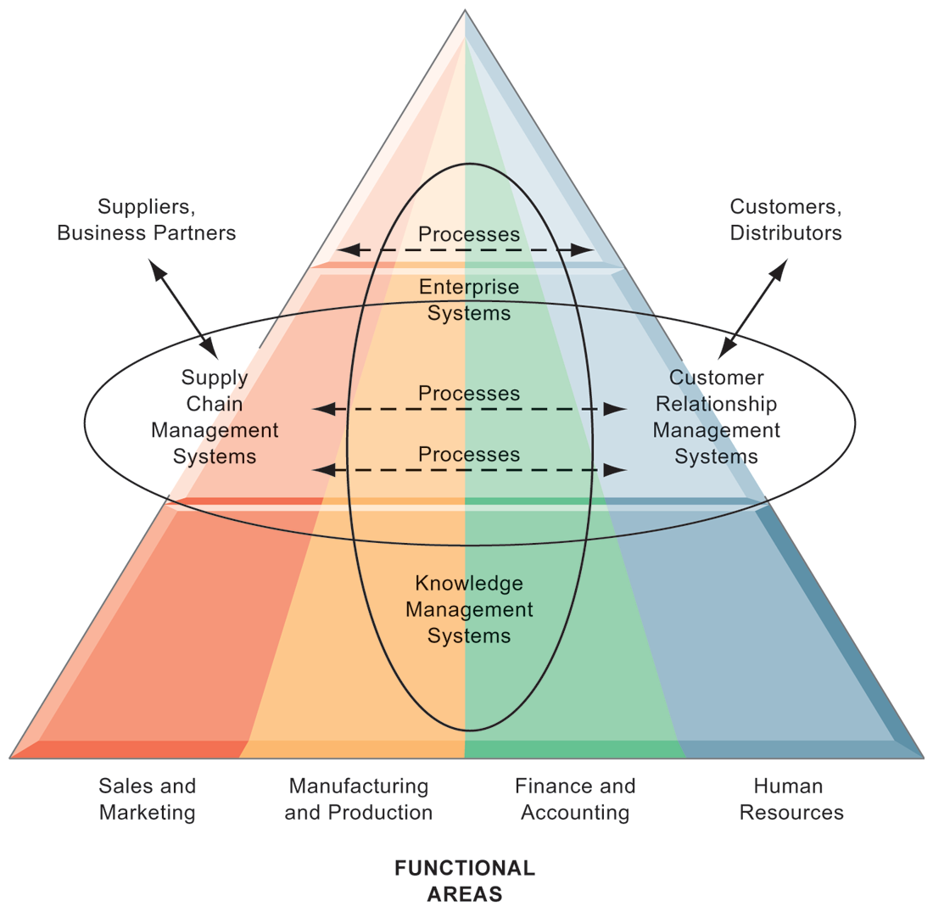
CHAPTER 2: GLOBAL E-BUSINESS AND COLLABORATION
Enterprise Application Architecture
Type of IS:
Enterprise applications automate processes that span multiple business functions and organizational levels and may extend outside the organization.

Slide 74
CHAPTER 2: GLOBAL E-BUSINESS AND COLLABORATION
Types of Information Systems
Enterprise systems
Collects data from different firm functions and stores data in single central data repository
Resolves problem of fragmented, redundant data sets and systems
Enable:
Coordination of daily activities
Efficient response to customer orders (production, inventory)
Provide valuable information for improving management decision making

Slide 75
CHAPTER 2: GLOBAL E-BUSINESS AND COLLABORATION Supply Chain Management (SCM) systems
Types of Information Systems
Tedarik Zinciri Yönetimi (İng:Supply Chain Management,SCM) müşteriye, doğru ürünün, doğru zamanda, doğru yerde, doğru fiyata tüm tedarik zinciri için en düşük maliyetle ulaşmasını sağlayan malzeme, bilgi ve para akışının entegre yönetimini içeren yazılım.
Manage firm’s relationships with suppliers
Share information about
Orders, production, inventory levels, delivery of products and services
Goal: Right amount of products to destination with least amount of time and lowest cost

Slide 76
Tedarik Zinciri Yönetimi (İng: Supply Chain Management, SCM) müşteriye, doğru ürünün, doğru zamanda, doğru yerde, doğru fiyata tüm tedarik zinciri için mümkün olan en düşük maliyetle ulaşmasını sağlayan malzeme bilgi bilgive para akışının entegre yönetimidir.
Tedarik Zinciri Yönetimi (İng: Supply Chain Management, SCM) müşteriye, doğru ürünün, doğru zamanda, doğru yerde, doğru fiyata tüm tedarik zinciri için mümkün olan en düşük maliyetle ulaşmasını sağlayan malzeme, bilgi ve para akışının entegre yönetimidir.

Slide 77
Supply Chain Management Systems
Firms use supply chain management (SCM) systems to help manage relationships with their suppliers.
These systems help suppliers, purchasing firms, distributors, and logistics companies share information about orders, production, inventory levels, and delivery of products and services so that they can source, produce, and deliver goods and services efficiently.
The ultimate objective is to get the right amount of their products from their source to their point of consumption in the least amount of time and at the lowest cost.
These systems increase firm profitability by lowering the costs of moving and making products and by enabling managers to make better decisions about how to organize and schedule sourcing, production, and distribution.
Supply chain management systems are one type of interorganizational system because they automate the flow of information across organizational boundaries.

Slide 78
Tedarik Zinciri Yönetimi-1 “Supply Chain Management” (chapter-2)
Tedarik Zinciri Yönetimi: Satıcılar, Dağıtıcılar,Müşteriler ve taşıma gereksinmelerini bir bütün olarak yönetmeyi sağlayan disiplin.
Tedarik Zinciri Yönetimi Sistemi : Şirketin mal ve hizmet gereksinmesini planlayan, kaynak akışını düzenleyen, tüm satıcılarla ilişkisini ve bilgi/veri alışverişini çevrim-içi yapıda sağlayan bilgi sistemi ile yazılım ve BS alt yapısını tanımlayan sistem.
Perakendeciler
Satıcılar
ŞİRKET
Üreticiler
Dağıtıcılar

Slide 79
Tedarik Zinciri Yönetimi-2 “Supply Chain Management” (chapter-2)
Sağlatıcılar
Miktar-Stok düzeyi-Taşıma planı-Ödeme Koşulları
Sipariş- Geri verilen- Tamir ve servis- Ödemeler
Satıcılar
İmalatçılar
Dağıtıcılar
Peraken-
deciler
Müşteriler
sağlayıcılar
Satıcılar

Slide 80
Tedarik Zinciri Yönetimi-3 “Supply Chain Management-SCM”
BT‘in Tedarik Zinciri Yönetimi Sisteminin Etkisi:
-Hangi malzemenin, ne zaman, ve depolanıp, kullanıla-cağına karar verme,
-Siparişin zamanında yapılmasını sağlama,
-Siparişi izleme,
-Mal stokunun kullanılabilirliğini ve stok düzeylerini,
-Stok,taşıma,ve depolama maliyetini azaltma
-Taşımayı/Nakliyeyi izleme,
-Gerçek müşteri isteklerine göre üretim planlamasına,
-Ürün tasarımındaki değişimi izlemeye

Slide 81
Tedarik Zinciri Yönetimi-4 “Supply Chain Management-SCM” (chapter-2)
Tedarik Zinciri Yönetimi TZY: Bir dizi ilişkili işlemi içine alır:
1- Planlamaya katkısı: Sipariş planlaması, İş ve üretim planlaması,İstek(talep) planlaması, Dağıtım planlaması, Taşıma planlaması.
2- İş yürütümüne katkısı: İstek gerçekleştirme, Son ürün sağlama, depolama işlemi,dağıtım yürütümü,yedekleme yürütümü ve izleme
3- Ticari e üretim işbirliğini sağlama: Satış/pazarlama, Üretim, tasarım-mühendisliği, gereksinmeler, müşteriler vb.
Kurum
Dış-Ağı
Satış/Pazarlam
Müşteriler
Mühendislik
Satıcılar
Üretim

Slide 82
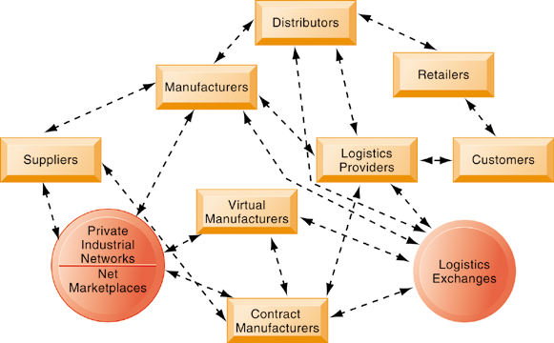
Example: Data flow in Drive Supply Chain
It provides multidirectional communication among firms, networks of firms, and e-marketplaces so that entire networks on distribution of relivent data
Notes:
This graphic illustrates the multidirectional communications within a future supply chain driven by the Internet. Private industrial networks and net marketplaces are discussed in Chapter 10. Private industrial networks are typically a large firm using an extranet to link to its suppliers and other key business partners. Net marketplaces are digital marketplaces based on Internet technology for many different buyers
and sellers
82

Slide 83
Müşteri ilişkileri yönetimi, mevcut müşterileri korumak, gelecekte müşteri memnuniyeti oluşturmak yönündeki yazılımlar ile müşteri bilgilerini kayıt altında tutarak işletme davranışlarını geliştirme yönetimidir. Satış, Pazarlama, Müşteri servisleri ve teknik destek programları ile müşteri ilişkilerinin temel yapısını içine alabilir.

Slide 84
Types of Information Systems Customer Relationship Management CRM System
Müşteri ilişkileri yönetimi, mevcut müşterileri korumak, gelecekte müşteri memnuniyeti oluşturmak yönündeki yazılımlar ile müşteri bilgilerini kayıt altında tutarak işletme davranışlarını geliştirme yönetimidir. Satış, Pazarlama, Müşteri servisleri ve teknik destek programları ile müşteri ilişkilerinin temel yapısını içine alabilen yazılım.
Provide information to coordinate all of the business processes that deal with customers in sales, marketing, and service to optimize revenue, customer satisfaction, and customer retention
Integrate firm’s customer-related processes and consolidate customer information from multiple communication channels

Slide 85
Müşteri İlişkileri Yönetimi -(Customer Relationship Management-CRM)
Müşteri İlişkileri Yönetimi: Kurumun çevreleyen etkileşim içinde olunan tüm birimlerin- müşterilerle ilişkili : satış,pazarlama ve hizmetlerinin işleyişinin bilgi sistemi ile eşgüdümünü sağlayan bir disiplindir.
Müşteri memnuniyeti, Pazar ilişkileri, eğilimlerini izleyip değerlendirilmesini, ilişkili birimlerle birlikte çalışmasını sağlayan yazılım ve donanımın desteklediği bilgi sistemine Müşteri İlişkileri Yönetimi Sistemi adı verilir.
Pazarlama:
Kampanya-İçerik-
Veri Çözümlemesi
Satış:
Telefon-Web-
Mağaza-Gezgin
Servis:
Çağrı Merkezi-
Web-servisi-
Uzaktan-servis
MÜŞTERİ

Slide 86
Müşteri ilişkileri –Müşteri ile tek noktadan haberleşme
E-posta %18
Doğrudan iletişim %30
Web %16
Cep Telefonu %7
Telefon %29

Slide 87
Customer Relationship Management Systems
Firms use customer relationship management (CRM) systems to help manage their relationships with their customers.
CRM systems provide information to coordinate all of the business processes that deal with customers in sales, marketing, and service to optimize revenue, customer satisfaction, and customer retention.
This information helps firms identify, attract, and retain the most profitable customers; provide better service to existing customers; and increase sales.

Slide 88
CUSTOMER INTIMACY: ENTERPRISE APPLICATIONS
CRM software
CRM packages range from niche tools to large-scale enterprise applications
More comprehensive have modules for:
Partner relationship management (PRM)
Integrating lead generation, pricing, promotions, order configurations, and availability
Tools to assess partners’ performances
Employee relationship management (ERM)
E.g. Setting objectives, employee performance management, performance-based compensation, employee training
© Pearson Education 2012
88
Notes:
88

Slide 89
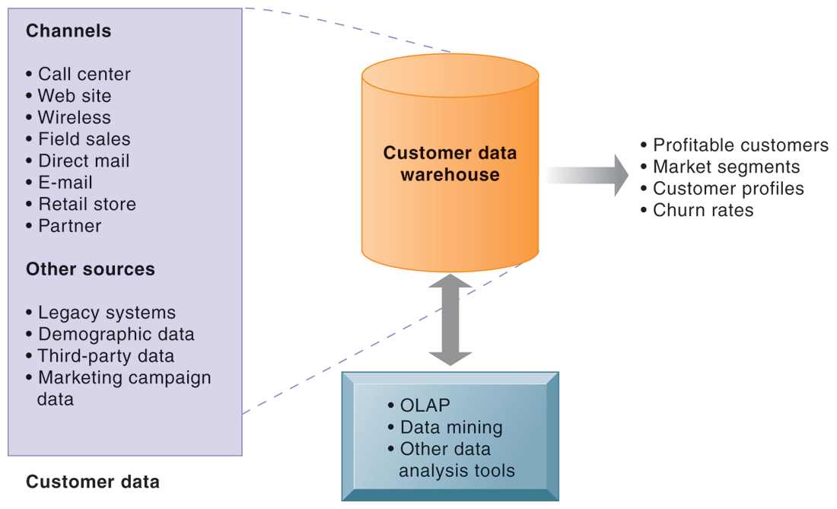
CRP Application Analytical CRM uses a custom89er data warehouse and tools to analyze customer data collected from the firm’s customer touch points and from other sources.
© Pearson Education 2012
© Pearson 84Education 2012
84

Slide 90
Knowledge management (KM) is the process of capturing, developing, sharing, and effectively using organisationalknowledge. It refers to a multi-disciplined approach to achieving organisational objectives by making the best use of knowledge.

Slide 91
Knowledge management systems (KMS)
Types of Information Systems – Senior management
Knowledge management (KM) is the process of capturing, developing, sharing, and effectively using organisational knowledge. It refers to a multi-disciplined approach to achieving organisational objectives by making the best use of firm exprience and knowladge using creative software methods.
Knowledge management systems (KMS)
Support processes for acquiring, creating, storing, distributing, applying, integrating knowledge
How to create, produce, distribute products and services
Collect internal knowledge and experience within firm and make it available to employees
Link to external sources of knowledge

Slide 92
CHAPTER 2: GLOBAL E-BUSINESS AND COLLABORATION
Types of Information Systems – Senior management
Knowledge management systems (KMS)
Support processes for acquiring, creating, storing, distributing, applying, integrating knowledge
How to create, produce, distribute products and services
Collect internal knowledge and experience within firm and make it available to employees
Link to external sources of knowledge

Slide 93
Knowledge Management Systems
Some firms perform better than others because they have better knowledge about how to create, produce, and deliver products and services.
Knowledge management systems (KMS) enable organizations to better manage processes for capturing and applying knowledge and expertise.
These systems collect all relevant knowledge and experience in the firm, and make it available wherever and whenever it is needed to improve business processes and management decisions.
They also link the firm to external sources of knowledge.

Slide 94
Knowledge management systems
Knowledge management systems enable firms
to optimize the creation, sharing, and distribution of knowledge.
Intranets and extranets are private corporate networks based on Internet technology that assemble information from disparate systems.
Extranets make portions of private corporate intranets available to outsiders.

Slide 95
How do systems that link the enterprise improve organizational performance?
Enterprise applications are designed to coordinate multiple functions and business processes. Enterprise systems integrate the key internal business processes of a firm into a single software system to improve coordination and decision making.
Supply chain management systems (SCM) help the firm manage its relationship with suppliers to optimize the planning, sourcing, manufacturing, and delivery of products and services.
Customer relationship management (CRM) systems coordinate the business processes surrounding the firm’s customers. Knowledge management systems enable firms to optimize the creation, sharing, and distribution of knowledge.
Intranets and extranets are private corporate networks based on Internet technology that assemble information from disparate systems. Extranets make portions of private corporate intranets available to outsiders.

Slide 96
CHAPTER 2: GLOBAL E-BUSINESS AND COLLABORATION
Types of Information Systems
Alternative tools that increase integration and expedite the flow of information
Intranets:
Internal company Web sites accessible only by employees
Extranets:
Company Web sites accessible externally only to vendors and suppliers
Often used to coordinate supply chain

Slide 97
“Types of Information Systems” Digital relationship with costomers,employees,suppliers,and logisctics upon Internet and networks. covers : electronic business,electronic commers and electronic government.
E-business
Use of digital technology and Internet to drive major business processes
E-commerce
Subset of e-business
Buying and selling goods and services through Internet
E-government:
Using Internet technology to deliver information and services to citizens, employees, and businesses

Slide 98
E-BUSINESS, E-COMMERCE, AND E-GOVERNMENT
The systems and technologies we have just described are transforming firms’ relationships with customers, employees, suppliers, and logistic partners into digital relationships using networks and the Internet.
Electronic business, or e-business, refers to the use of digital technology and the Internet to
execute the major business processes in the enterprise.
E-business includes activities for the internal management of the firm and for coordination
with suppliers and other business partners. It also includes electronic commerce, or
e-commerce.
E-commerce is the part of e-business that deals with the buying and selling of goods and services over the Internet. It also encompasses activities supporting those market transactions, such as advertising, marketing, customer support, security, delivery, and payment.
The technologies associated with e-business have also brought about similar changes in the public sector. Governments on all levels are using Internet technology to deliver information and services to citizens, employees, and businesses with which they work.
E-government refers to the application of the Internet and networking technologies to digitally enable government and public sector agencies’ relationships with citizens, businesses, and other arms of government.

Slide 99
What is the role of the information systems function in a business?
The information systems department is the formal organizational unit responsible for information
technology services. It is responsible for maintaining the hardware, software, data storage, and
networks that comprise the firm’s IT infrastructure. The department consists of specialists, such as
programmers, systems analysts, project leaders, and information systems managers, and is often
headed by a CIO.

Slide 100
Integrated Information Systems Enterprise Resource Planning (ERP) systems
Enterprise Systems : Also called “enterprise resource planning (ERP) systems” (or attempt to integrate) all data and processes of an organization into a single unified system.
A typical ERP system will use multiple compo- nents of computer software…
The software is a Suite of integrated software modules and a common central database.

Slide 101
Bir bütünleşme çözümü: Kurumsal Kaynak Planlama “Enterprise Resource Planning (ERP) system”
Müşteri
İlişkileri
Ürün
Yönetimi
Tedarik
Zinciri
Satış/Sipariş
İleri
Planlama
Mali İşler Yönetimi
Pazarlama
Proje/Yatırım Yönetimi
İnsan Kaynakları Yönetimi
Tedarik
Yönetimi
Bakım Yönetimi
Satış Sonrası
Hizmetler
Üretim
Çizelgeleme
Mal/Hizmet
Temin
Notes:
Next, all of our applications are built for e-Business. They are all 100% Internet based - which means that all you need to access the applications is a web browser on your desktop.
The business flows are all integrated end-to-end.
And most importantly, the applications themselves have been developed with built-in support for all the new internet-enabled e-Business practices.

Slide 102
Kurumsal Kaynak Planlaması-KKP
(Enterprice Resource Planing)
Kurumsal kaynak planlaması (KKP) anlam olarak, işletmenin tüm kaynaklarının birleştirilip, verimli olarak kullanılması için tasarlanmış bütünleşik sistem demektedir.
Alışılagelmiş bir KKP yazılımı işlem yapabilmek için BT’nin çeşitli yazılım ve donanım olanaklarını kullanır.
ERP sistemleri; tedarik zinciri yazılımı, üretim yazılımı, finansal yönetim yazılımı, proje yönetimi yazılımı ve insan kaynakları yönetimi, müşteri yönetimi yazılımı… vb çeşitli iş sürerlerini içerir. İşimize göre bu süreçlerin bütününü veya bir kısmını içine alan esnek bir sistemdir.

Slide 103
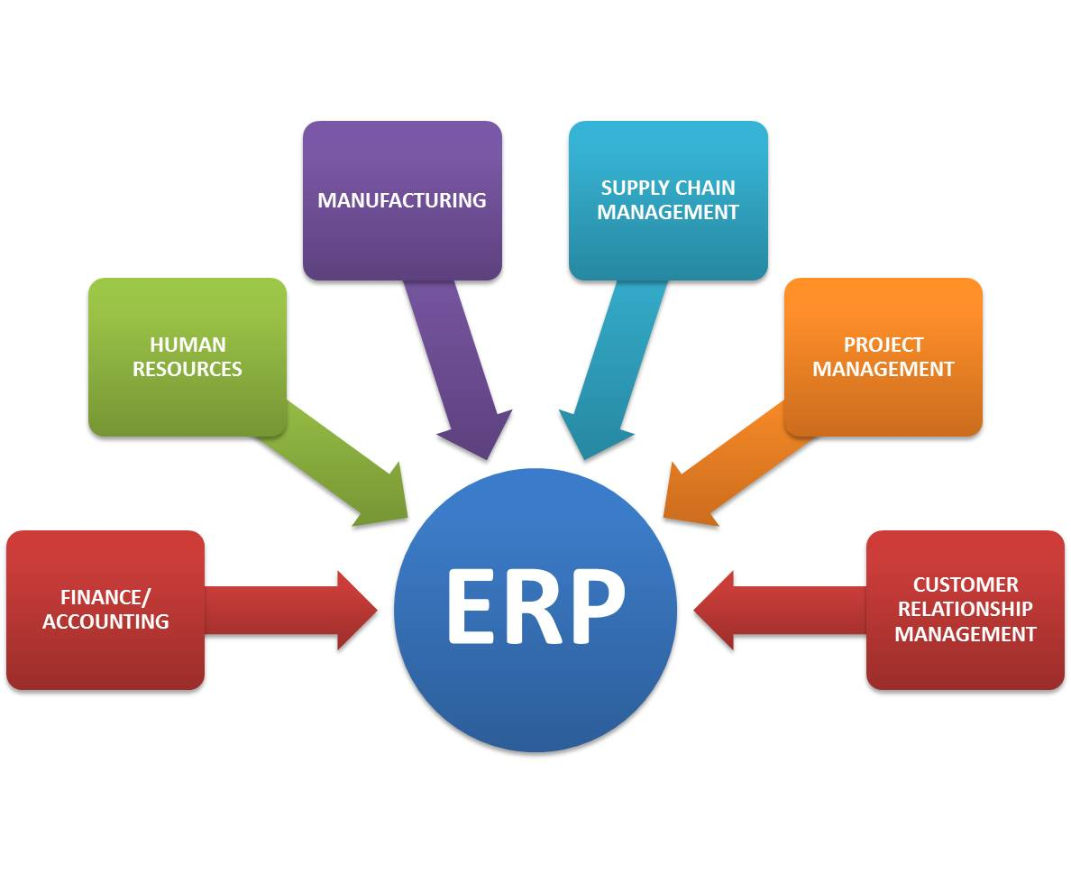

Slide 104
ACHIEVING OPERATIONAL EXCELLENCE AND CUSTOMER INTIMACY: ENTERPRISE APPLICATIONS
Enterprise Systems
Enterprise Systems
Also called “enterprise resource planning (ERP) systems”
Suite of integrated software modules and a common central database
Collects data from many divisions of firm for use in nearly all of firm’s internal business activities
Information entered in one process is immediately available for other processes
104
© Pearson Education 2012
Notes:
104

Slide 105
Enterprise Systems
ERP provides an integrated view of core business processes, often in real-time, using common databases maintained by a database management system.
ERP systems track business resources—cash, raw materials, production capacity—and the status of business commitments: orders, purchase orders, and payroll.
The applications that make up the system share data across the various departments (manufacturing, purchasing, sales, accounting, etc.) that provide the data.
ERP facilitates information flow between all business functions, and manages connections to outside stakeholders.^{[2]}

Slide 106
Enterprise Systems and ERP System “Enterprise system integrate the key busines processes” .
ERP System integrate business processes in manufacturing and production, finance and accounting, sales and marketing,and human resources into a single software system. Information that was previously fragmented in many different systems is stored in a single comprehensive data repository where it can be used by many different parts of the business .
For example, when a customer places an order, the order data flow automatically to other parts of the company that are affected by them. The order transaction invokes the warehouse to pick the ordered products and schedule shipment. The warehouse informs the factory to replenish whatever has been depleted. The accounting department is notified to send the customer an invoice. Customer service represent- atives track the progress of the order through every step to inform customers about the status of their orders.

Slide 107
Enterprice Resource Planing
Software Modules
ERP software typically consists of multiple enterprise software modules that are individually purchased, based on what best meets the specific needs and technical capabilities of the organization.
Each ERP module is focused on one area of business processes, such as product development or marketing. A business scan use ERP software to manage back-office activities and tasks including the following:
Distribution process management, supply chain management, services knowledge base, prices, improve accuracy of financial data, facilitate better project planning, automate employee life-cycle, standardize critical business procedures, business needs, accounting and financial applications, lower purchasing costs, manage human resources and payroll etc.
ERP

Slide 108
Enterprice Resource Planing
ERP, -iş süreçlerini optimize eden ve birçok fonksiyonu barındıran kurumsal kaynak planlama çözümüdür. Esneklik, yüksek müşteri memnuniyet oranı, kullanıcı dostluğu ve fiyat/performans oranı gibi kriterlerde öne çıkan ERP yazılımları bugün 3.000'e yakın firmada 28 farklı lisanda kullanılmaktadır...
Üretim – İmalat , satış ve Pazarlama alanlarında ağırlıklı konularda kullanılır. Örneğin;
ERP For Manufacturing
ERP for Fashion Industries
Engineer-to-Order (ETO ERP)
ERP for the Oil and Gas Industry (Upstream)
Mining Industry (ERP-CMMS)
ERP for Mill-based and Material Converting Environments
ERP for Services (Non-manufacturing)
Quote-to-Order (Q2O) Systems

Slide 109
Management Information System
Why are systems for collaboration and teamwork so important and what technologies do they use?
SYSTEMS FOR COLLABORATION AND TEAMWORK
What Is Collaboration?
Business Benefits of Collaboration and Teamwork
Building a Collaborative Culture and Business Processes
Tools and Technologies for Collaboration and Teamwork

Slide 110
CHAPTER 2: GLOBAL E-BUSINESS AND COLLABORATION
“Takım Çalışması ve İşbirliği”
Systems for Collaboration and Teamwork
Collaboration:
Short-lived or long-term
Informal or formal (teams)
Growing importance of collaboration:
Changing nature of work
Growth of professional work – “interaction jobs”
Changing organization of the firm
Changing scope of the firm
Emphasis on innovation
Changing culture of work

Slide 111
CHAPTER 2: GLOBAL E-BUSINESS AND COLLABORATION
Systems for Collaboration and Teamwork
Business benefits of collaboration and teamwork
Investments in collaboration technology can produce organizational improvements returning high ROI
Benefits:
Productivity
Quality
Innovation
Customer service
Financial performance
Profitability, sales, sales growth

Slide 112
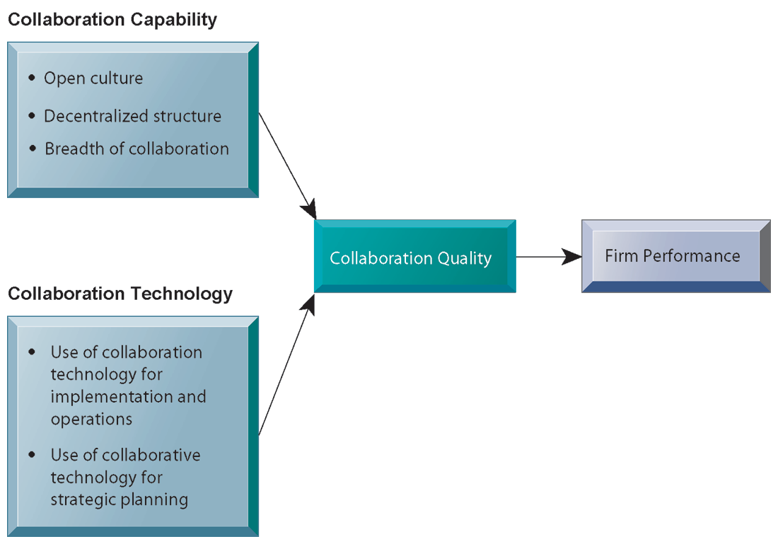
CHAPTER 2: GLOBAL E-BUSINESS AND COLLABORATION
Requirements for Collaboration : organizational structure and culture
Systems for Collaboration and Teamwork
Successful collaboration requires an appropriate organizational structure and culture, along with appropriate collaboration technology.

Slide 113
CHAPTER 2: GLOBAL E-BUSINESS AND COLLABORATION
Systems for Collaboration and Teamwork
Building a collaborative culture and business processes
“Command and control” organizations
No value placed on teamwork or lower-level participation in decisions
Collaborative business culture
Senior managers rely on teams of employees
Policies, products, designs, processes, systems rely on teams
Managers purpose is to build teams

Slide 114
CHAPTER 2: GLOBAL E-BUSINESS AND COLLABORATION
Systems for Collaboration and Teamwork
Technology for collaboration and teamwork
15 categories of collaborative software tools
Email and instant messaging White boarding
Collaborative writing Web presenting
Collaborative reviewing Work scheduling
Event scheduling Document sharing /wikis
File sharing Mind mapping
Screen sharing Large audience Webinars
Audio conferencing Co-browsing
Video conferencing

Slide 115
CHAPTER 2: GLOBAL E-BUSINESS AND COLLABORATION
Systems for Collaboration and Teamwork
Technology for collaboration and teamwork (cont.)
Social Networking
Wikis
Virtual Worlds
Internet-Based Collaboration Environments
Virtual meeting systems (telepresence)
Google Apps/Google sites
Microsoft SharePoint
Lotus Notes

Slide 116
CHAPTER 2: GLOBAL E-BUSINESS AND COLLABORATION
Systems for Collaboration and Teamwork
Two dimensions of collaboration technologies
Space (or location) – remote or colocated
Time – synchronous or asynchronous
Six steps in evaluating software tools
What are your firm’s collaboration challenges?
What kinds of solutions are available?
Analyze available products’ cost and benefits
Evaluate security risks
Consult users for implementation and training issues
Evaluate product vendors

Slide 117
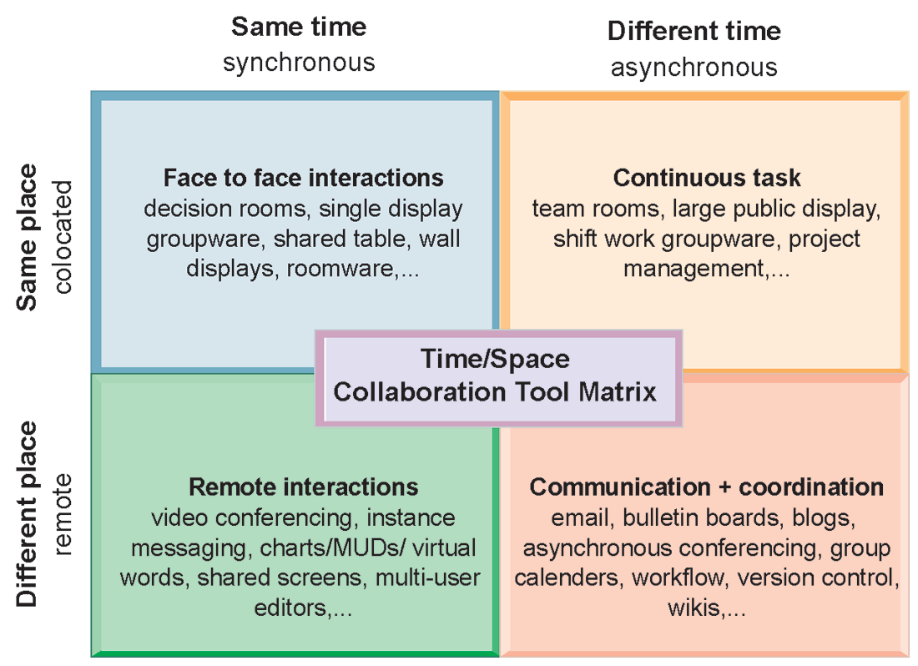
The Time/Space Collaboration Tool Matrix
Collaboration technologies can be classified in terms of whether they support interactions at the same or different time or place whether these interactions are remote or co-located..
FIGURE 2-8

Slide 118
Why are systems for collaboration and teamwork so important and what technologies do they use?
Collaboration is working with others to achieve shared and explicit goals. Collaboration and teamwork have become increasingly important in business because of globalization, the decentraliza-tion of decision making, and growth in jobs where interaction is the primary value-adding activity.
Collaboration is believed to enhance innovation, productivity, quality, and customer service.
Effective collaboration today requires a supportive organizational culture as well as information

Slide 119
Management Information System
What is the role of the information
systems function in a business?
THE INFORMATION SYSTEMS FUNCTION IN BUSINESS
The Information Systems Department
Organizing the Information Systems Function

Slide 120
CHAPTER 2: GLOBAL E-BUSINESS AND COLLABORATION
The Information Systems Function in Business
Business need to operate diffrent kind of business information systems and related hardware, software and communication systems. The formal organzational unit , Information System Department is responciple for all IT services and IT inftrastructure.
Information systems department:
Formal organizational unit responsible for information technology services
Often headed by chief information officer (CIO)
Other senior positions include chief security officer (CSO), chief knowledge officer (CKO), chief privacy officer (CPO)
Programmers
Systems analysts
Information systems managers

Slide 121
CHAPTER 2: GLOBAL E-BUSINESS AND COLLABORATION
The Information Systems Function in Business
End users (*)
Representatives of other departments for whom applications are developed
Increasing role in system design, development
IT Governance:
Strategies and policies for using IT in the organization
Decision rights
Accountability
Organization of information systems function
Centralized, decentralized, et
(*) End user: representatives of departments out side of IS group .
end-user will run and develop his job using software interface .
End users are interest on solving business problems or organizational task

Slide 122
CHAPTER 2: GLOBAL E-BUSINESS AND COLLABORATION
The Information Systems Function in Business
Information systems department:
Formal organizational unit responsible for information technology services
Often headed by chief information officer (CIO)
Other senior positions include chief security officer (CSO), chief knowledge officer (CKO), chief privacy officer (CPO)
Programmers
Systems analysts
Information systems managers

Slide 123
What is the role of the information systems function in a business?
The information systems department is the formal organizational unit responsible for information technology services. It is responsible for maintaining the hardware, software, data storage, and networks that comprise the firm’s IT infrastructure.
The department consists of specialists, such as
programmers, systems analysts, project leaders, and information systems managers, and is often
headed by a CIO.

Slide 124
End of Lecture two here is some additional information
Here is some additional information
which Computer Engineer must
1- Veri Yakalama Toplama “Data Capturing /Acqusition”-
2- İş Stratejisi (izlemi)-Karar Alma – İş Zekası

Slide 125
Classification of IS
MIS-
Information Systems
Operations Support System
Management Support System
Transaction processing systems
Tutanak işleme Alt-Sistemi
Office automation systems
Management information systems
Yönetim Bilgi Alt-Sistemi
Decision support systems
Karar Destek Alt-Sistemi
Executive information systems
Üst-Yönetici Karar Destek Alt-Sistemi
Process control systems

Slide 126
Veri Yakalama Toplama “Data Capturing /Acqusition”-
Çevrim İçi Tutanak İşleme Sisteminin bir parçası veri yakalama sistemleridir:
Veri toplamada veri girişine hız ve kolaylık kazandıran donanım ve bu donanıma özgü yazılımlar kullanılır.
Günümüzde, kablosuz iletişim ve Internet teknolojileri,verinin çevri-içi ve gerçek zamanlı sistemleri uygulamada veri girişini sağlar.
Veri toplama verinin tanımlanması ya da algılanması, sisteme girmesi ya da özdevimli algılayıcılarla yakalanması, verinin denetlenmesi gibi işlevlerin tamamını kapsar.

Slide 127
Veri Yakalama Toplama : Alışılagelen VERİ GİRİŞİ”nden “OTOMATİK TANIMA”ya ... Uzanan çeşitli yöntemler kullanır
OTOMATİK TANIMA (Automatic Identification - Auto ID )
Yöntemleri çok gelişmiştir.
Barkod (Barcode)
Manyetik Şerit (Magnetic Stripe)
OCR (Optical Character Recognition)
OMR (Optical Mark Recognition)
MICR (Magnetic Ink Character Recognition)
RFID (Radio Frequency Identification)
Matris Kodlar (2D Codes)
Ses Tanıma (Voice Recognition)
ICR (Intelligent Character Recognition)
Akıllı Kartlar (Smart Cards)
Akıllı Düğme (Smart Button / Touch Button)
Biyometrik Tanıma (Parmak İzi, Göz İzi)
Kullanım alanlarını araştırınız!

Slide 128
Otomatik Tanıma Veri Toplama (OT/VT)
Barkod bilgisayara doğruluğunu ve hızını artıran Otomatik Tanıma Veri Toplama (OT/VT) uygulamalarında geniş bir kullanım alanı bulmaktadır.
Geleneksel olarak barkod kodlaması sadece rakamları sembolize ederken, yeni sembolojiler tüm ASCII karakter setine büyük harf ve daha fazlasını eklemiştir. Basit barkodların ihtiyaç duyduğu alana daha fazla bilgi sığdırma gereksinimi çizgiler yerine kare hücreleri içeren (bir tür İki boyutlu barkod) geliştirilmesine sebebiyet vermiştir. iki boyutlu ve tek boyutlu kodların karışımıdır ve geleneksel tek boyutlu sembolojiyi birden fazla satır içerecek şekilde bir çerçeve içinde yeniden boyutlandırma işlemidir.

Slide 129
Veri Yakalama Toplama Çubuklu kod “Barcode” veri tanımlama en yaygın girdi sistemidir
Verilerin aralıkları değişken bir dizi çizgi ya da çubuk işaretlerle
belirtildiği özdevinli okuma sistemi.
Çubuklu kod yazcı (bar-code printer) ve
Çubuklu kod okuyucu (bar code scanner),
Çubuklu kod kalem (Bar Code pen) öğelerden oluşur.
“A barcode is an optical machine-readable representation of data, which shows certain data on certain products. Originally, barcodes represented data in the widths (lines) and the spacings of parallel lines, and may be referred to as linear or 1D (1 dimensional) barcodes or symbologies. They also come in patterns of squares, dots, hexagons and other geometric patterns within images termed 2D (2 dimensional) matrix codes or symbologies ..”

Slide 130

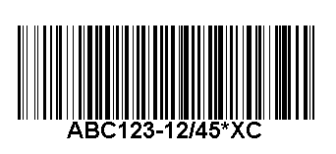

Çubuklu kod “Barcode” veri tanımlama en yaygın girdi sistemidir
Standart çubuk kod tanımları:
8
69 1111
12345
x
EAN
üyesi
firma
ürün
sağlama
firma
ürün
Code 39
Code 128 - B
Code 128 -
Gördüğünüz gibi barkod iki kısımdır. 1) Makinenin okuduğu dikey çizgiler kısmı; 2) insanların okuyabildiği 12 adet rakam. ilk altı rakam eşyanın tanım numarası olup bu kodları veren uluslararası bir konseyden kendi ürünlerine tahsis ettirebilirler.

Slide 131
Çubuklu kod “Barcode”
Barkod kullanmanın faydaları:
Satış noktası (POS) yönetiminde, barkod kullanımı önemli konular ile ilgili çok detaylı güncel bilgi sağlayarak işlemlerin daha hızlı ve güvenilir şekilde yerine getirilmesine imkân vermektedir. Örneğin:
Bar kod tarayıcıları ayrıca düşük maliyetlidir ve çok doğru okuma yapar -

Slide 132
Örneğin, Bar kod Veri Toplama Sistemleri Bilgi Sistemlerinde Geniş bir uygulama alanı bulmuştur. Kimi uygulama alanları:
ENDÜSTRİYEL UYGULAMALAR
Depo: giriş, mal kabulu, yerleştirme, yer ve birim değiştirme,
sevk hazırlama, yükleme, sayım
Endüstriyel Üretim İzleme: şçilik, malzeme, makine hareketleri,
ölçüm ve bakım
Kalite Kontrol: İzlenebilirlik
İŞYERİ UYGULAMALARI
Geçiş Güvenlik, Personel Devam İzleme, Demirbaş,
Belge / Dosya, İzleme, Taşımacılık / Kargo

Slide 133
Örneğin, Bar kod Veri Toplama Sistemleri Bilgi Sistemlerinde Geniş bir uygulama alanı bulmuştur. Kimi uygulama alanları:
MAĞAZACILIK : Depo: Ana Dağıtım Deposu,giriş, mal kabulu, yerleştirme, yer ve birim, değiştirme, dağıtım, sevkiyat, sayım, Mağaza Deposu, giriş, mal kabulu, yerleştirme, yer ve birim değiştirme, reyona çıkış, sayım
Toptan Satış, Perakende Satış, Fiyat Doğrulama vb
ALANDA VERİ TOPLAMA : Araçta Sipariş Toplama, Araçta Dağıtım ve Satış, Satış Sonrası Garanti ve Bakım Hizmetleri, Pazar İzleme, Sayaç Okuma, Sigortacılık, Enerji Dağıtımı ve Satışı

Slide 134
Data capture by mobile phone
A smartphone is a high-end mobile phone123 that combines the functions of a personal digital assistant (PDA) and a mobile phone.
Today's models typically also serve as portable media players and camera phones with high-resolution touchscreens, web browsers that can access and properly display standard web pages rather than only mobile-optimized sites, GPS navigation, Wi-Fi and mobile broadband access.
The term smartphone is usually used to describe phones with more advanced computing ability and connectivity than a contemporary feature phone, although the distinction can be vague and there is no official definition for what constitutes the difference between them. The definitions also shift over time since many phones that are considered feature phones today can have capabilities that exceed those of phones that had been promoted as smartphones in the past.

Slide 135
MANAGEMENT INFORMATION SYSTEMS ENHANCING DECISION MAKING
Decision making in businesses used to be limited to management.
Today, lower level employees are responsible for some of these
decisions, as Information Systems make information available to lower level of business.
TYPES OF DECISIONS :
STRUCTURED DECISIONS :Are repetetive and routıne decısıons and have a definite procedure for handling them. Structured Decisions do not have to be treated as if they are new .
UNSTRUCTURED DECISIONS: Nonroutine decisions in which the
decision maker must provide judgment. Evaluation, and insights into the problem definition; There is no agreed upon procedures for making such decisions.
SEMISTRUCTURED DECISIONS: Decisions in which only part of the
problem has a clear cut answer provided by an accepted procedure.

Slide 136
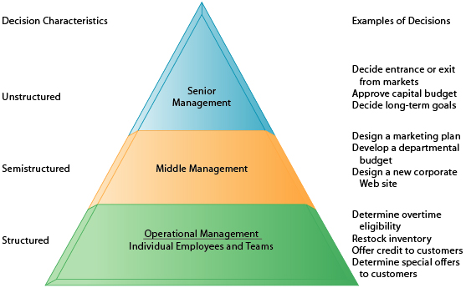
DECISION MAKING AND INFORMATION SYSTEMS Senior Managers, Middle Managers, Operational Managers and Employees have different types of Decisions and Information requirements.

Slide 137
DECISION MAKING AND INFORMATION SYSTEMS
SENIOR MANAGEMENT DECISIONS
Senior Executives face many unstructured decision situations, such as establishing the company’s five or ten years Goals or deciding new markets to enter.
Senior Management decision will require information from various informal and external sources; Such as news, government reports, and industry views as well as high level summaries of firm’s performance and also manager’s own best judgment and poll other managers for their opinions.
MIDDLE MANAGEMENT DECISIONS
Middle Management faces more Structural decısıon scenarıos but theır decısıons may ınclude Unstructural componentsç A typıcal Mıddle level Management decııson mıght be:
Why ıs the reported order fulfılment report showıng a declıne over the past sıx months at a dıstrıbutıon center?

Slide 138
DECISION MAKING AND INFORMATION SYSTEMS
Middle Manager need reports from the Enterprise System or Distribution Management System on Order activity and Operational efficiency at the Distribution center to make the structured part of the decision.
The middle manager will have to interview employees and gather more unstructured information from external sources about local economics conditions or sales trends before arriving at an answer.
OPERATIONAL MANAGEMENT DECISIONS
Operational Management and Rank- and- File Employees tend to make more Structural decisions.
e.g. A Supervisor on an assembly line has to decide whether an hourly paid worker is entitled to overtime pay. If the employee worked more than 8 hours on a particular day. The Supervisor would routinely grant overtime pay for any time beyond 8 hours that was clocked on that day.

Slide 139
DECISION MAKING AND INFORMATION SYSTEMS
OPERATIONAL MANAGEMENT DECISIONS
A Sales Account Representative often has to make decisions about extending credit limit to customers by consulting the Customer Database that contains credit information. If a customer met the prespecified criteria for granting credit Sales Account Representative will grand the customer credit to make a purchase.
The decisions in both examples are highly structured and are routinely made thousands of times each day.
The answer to the first example has been preprogrammed into the firms Payroll System
The answer to the second example has been preprogrammed into the firms Accounts Receivable System.

Slide 140
DECISION MAKING AND INFORMATION SYSTEMS
INFORMATION QUALITY
High Quality decisions require high Quality Information.
The Information Quality Dimensions
Accuracy
Integrity
Consistency
Completeness
Validity
Timelines
Accessibility
If the Output of the Systems does not meet these Quality criteria, Decision making will suffer.

Slide 141
Karar Alma Desteği
Yönetim Bilgi Sistemin beklenen bir önemli işlev, her düzeydeki yöneticilerin değerlendirme ve karar alma işlemlerini olabildiğince desteklemesini sağlayacak bilgiyi ya da üst-bilgiyi sağlamasıdır.
Karar desteği hem işletimsel süreçler (TPS) hem de yönetsel süreçler (MIS) için türetilir.
Karar gereksinmesi aşağıdan yukarıya doğru artarak büyür.
Yönetsel iş yürütmede; şirketlerin uğraş alanlarında üretim ve hizmetlerin ve bağlı iş süreçlerinin verimli sürdürülmesi, tedarikçiler, müşteriler, rakipler ve çevre ilişkileri ile gelişme ya da değiştirme konularında herekli zamanda gerekli kararları almayı kapsar.

Slide 142
Decision making is an integral part of the functioning of any organization.
Management information systems combine hardware, software and network products in an integrated solution that provides managers with data in a format suitable for analysis, monitoring, decision-making and reporting. The system collects data, stores it in a database and makes it available to users over a secure network.
Business intelligence (BI) is a set of theories, methodologies, processes, architectures, and technologies that transform raw data into meaningful and useful information for business purposes.
BI can handle large amounts of data making use of new opportunities and implementing an effective strategy can provide a competitive market advantage and long-term projects.
BI technologies provide historical, current and predictive views of business operations.
Common functions of business intelligence technologies are reporting, online analytical processing, analytics, data mining, process mining, complex event processing, business performance management, benchmarking, text mining, predictive analytics and prescriptive analytics.

Slide 143
Karar düzeylerinin ilişkisi ve karar türleri
Tanımsız
Tanımlı
İşletimsel Yönetsel Stratejik

Slide 144
Management is essentially a decision-making process
Decision making is the process by which a choice is madebetween several courses of action.
In other words, it is the process which results in a commitment to a course of action.. As we shall see, this decision making process includes stages such as gathering information and identifying possible options as well as actually determining what action should be taken.
One of the organizational roles of a manager is that of decision maker. In this role, the manager analyzes information to make informed decisions.

Slide 145
Six elements in the business intelligence environment
Data from the business environment
Business intelligence infrastructure
Business analytics toolset
Managerial users and methods
Delivery platform – MIS, DSS, ESS
User interface

Slide 146
Business intelligence users
80% are users relying on production reports
Senior executives
Use monitoring functionalities
Middle managers and analysts
Ad-hoc analysis
Operational employees
Prepackaged reports
E.g. sales forecasts, customer satisfaction, loyalty and attrition, supply chain backlog, employee productivity

Slide 147
EK Bilgi
1-BPEL (Business Process Execution Language)
2- Bir Tedarik Zinciri Yönetimi Yazılımı Paketi içerik örneği
3- Kimi anahtar sözcük ve terimler

Slide 148
BPEL (Business Process Execution Language)
The Web Services Business Process Execution Language (WS-BPEL), commonly known as BPEL (Business Process Execution Language), is a standard executable language for specifying actions within business processes with web services.
Processes in BPEL export and import information by using web service interfaces exclusively.
The goal of the Web Services effort is to achieve universal interoperability between applications by using Web standards.
Web Services use a loosely coupled integration model to allow flexible integration of a variety of domains including business-to-consumer, business-to-business and enterprise application integration.
Referace: OASIS Standard WS-BPEL 2.0
Business Process Execution Language for Web Services, Version 1.1 (PDF) (5 May 2003)

Slide 149
BPEL (Business Process Execution Language)
BPEL (Business Process Execution Language) is an XML-based language that allows Web services in a service-oriented architecture (SOA) to interconnect and share data.
Programmers use BPEL to define how a business process that involves web services will be executed. BPEL messages are typically used to invoke remote services, orchestrate process execution and manage events and exceptions.
BPEL is often associated with Business Process Management Notation (BPMN), a standard for representing business processes graphically.
In many organizations, analysts use BPMN to visualize business processes and developers transform the visualizations to BPEL for e An entity-relationship diagram (ERD) is a graphical representation of an information system that shows the relationship between people, objects, places, concepts or events within that system.

Slide 150
BPEL (Business Process Execution Language)
An ERD is a data modeling technique that can help define business processes and can be used as the foundation for a relational database.
While useful for organizing data that can be represented by a relational structure, an entity-relationship diagram can't sufficiently represent semi-structured or unstructured data, and an ERD is unlikely to be helpful on its own in integrating data into a pre-existing information system.
Three main components of an ERD are the entities, which are objects or concepts that can have data stored about them, the relationship between those entities, and the cardinality, which defines that relationship in terms of numbers.

Slide 151
BPEL (Business Process Execution Language)
For example, an ER diagram representing the information system for a company's sales department might start with graphical representations of entities such as the sales representative, the customer, the customer's address, the customer's order, the product and the warehouse.
(See diagram) Then lines or other symbols can be used to represent the relationship between entities, and text can be used to label the relationships.
Finally, cardinality notations define the attributes of the relationship between the entities.
Cardinalities can denote that an entity is optional (for example, a sales rep could have no customers or could have many) or mandatory (for example, the must be at least one product listed in an order.)

Slide 152
Tedarik Zinciri Yönetimi Yazılımı ilişkili bir çok işlemi içine alır. İşte bir örnek-1
Tedarik Zinciri Planlama
Satış ve Operasyon Planlama
Talep Planlama
Kapasite Planlama
Üretim Planlama Yönetimi
Müşteri Hizmetleri Yönetimi
Servis Seviyesi Belirleme ve Ölçme
Alokasyon Yönetimi ve Önceliklendirme
EDI ve Müşteri Hizmetleri

Slide 153
Tedarik Zinciri Yönetimi Yazılımı ilişkili bir çok işlemi içine alır. İşte bir örnek-2
Lojistik Yönetimi
Tedarik Zincirinde Dağıtımın Rolü
Dağıtım Ağını Belirleyen Faktörler, Dağıtım Politikaları
Fiziksel Dağıtım ve Evreleri
Lojistik Yönetim Sistemi Bileşenlerinde Yeri
Fiziksel Dağıtımın Maliyetler Açısından İncelenmesi
Fiziksel Dağıtımda Lojistik Yönetim Anlayışının Gelişimi
Fiziksel Dağıtım Öğelerinin İncelenmesi
Müşteri Hizmetleri / Depolama Kararı / Envanter Yönetimi / Üretim Yönetimi ve Malzeme İhtiyaç Planlama
Fiziksel Dağıtım Stratejisini Etkileyen Faktörler
Taşıma Kararları / Taşıma Yönteminin Seçimi ( 3. Taraf Lojistik Firmalar )
Nakliye Alternatifleri
Nakliye Maliyeti ve Tedarik Zinciri Duyarlılığı Açısından İlişki
Gıda ve Soğuk Zincir Lojistiği

Slide 154
Tedarik Zinciri Yönetimi Yazılımı ilişkili bir çok işlemi içine alır. İşte bir örnek-3
Depo Yönetimi
Depo Yeri Belirleme, Depo Tesis Yapısı ve Ekipman - Donanım Seçimi
Depo İç Düzeni Planlaması
Etkin Depo Yönetimi
Maliyet Planlaması
Depo Verimlilik Esasları ve Hesapları
Temel Depolama Prosedürleri
FİFO-LİFO
KAİZEN
Depo Bilgi Yönetimi Sistemleri, Malzeme Kodlama Sistemleri
Envanter Yönetimi
Temel Envanter Konseptleri
Güvenlik Stokları Yönetimi
Kötü Envanter Yönetimi Semptomları
VMI (Vendor Managed Inventory)
Müşteri Hizmetleri ve Envanter Yönetimi

Slide 155
Tedarik Zinciri Yönetimi Yazılımı ilişkili bir çok işlemi içine alır. İşte bir örnek:-4
İleri Düzey Tedarik Zinciri Yönetimi
Tedarik Zinciri SCOR ( Supply Chain Operation Reference ) Modeli
ECR ( Efficient Costumer Responce - Etkin Tüketici Yanıtı ) ve Türkiye Uygulamaları
CPFR ( Collaborative Planning - Forecasting )
Tedarik Zinciri Performans Yönetimi
Tedarik Zinciri vs. Değer Zinciri
İşletmede Değer Yaratan Faaliyetlerin Belirlenmesi
Değerin Yaratılması / Müşteri İçin Değerin Yaratılması
Değer Zinciri Analizinde Safhalar
Değer Zincirinde Kalitesizlik Maliyetleri ya da Kalite Maliyetleri Yönetimi
Kalite Maliyetlerinin Kullanım Alanları / Kalite Maliyet Sisteminin Amacı
Önleme Maliyetleri / Ölçme-Değerleme Maliyetleri
İçsel ve Dışsal Başarısızlık Maliyetleri
Planlama Performans Kriterleri
Envanter Performans Kriterleri
Lojistik Performans Kriterleri
Depo Performans Kriterleri
Exception Based Management & Reporting
Tedarik Zincir ve Bilgi Sistemleri
ERP Sistemleri
İleri Düzey Planlama Sistemleri
VMI Sistemleri
Internet ve Tedarik Zinciri

Slide 156
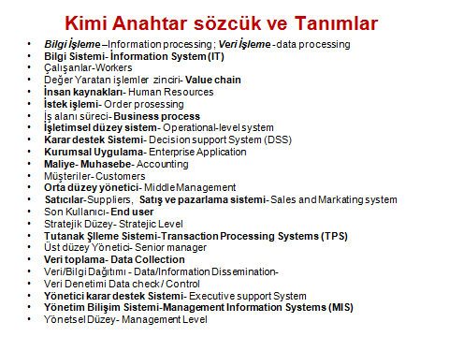
SÖZLÜK

Slide 157
Key Terms
Business intelligence, 49
Chief information officer (CIO), 68
Chief knowledge officer (CKO), 69
Chief privacy officer (CPO), 69
Chief security officer (CSO), 68
Collaboration, 56
Customer relationship management (CRM) systems, 53
Decision-support systems (DSS), 48
Digital dashboard, 50
Electronic business (e-business), 55
Electronic commerce (e-commerce), 55
E-government, 55
End users, 69
Enterprise applications, 51
Enterprise systems, 51
Executive support systems (ESS), 50
Information systems department, 68
Information systems managers, 68
Interorganizational system, 53
IT governance, 69
Knowledge management systems (KMS), 54
Management information systems (MIS), 47
Portal, 50
Programmers, 68
Supply chain management (SCM) systems, 53
Systems analysts, 68
Teams, 56
Telepresence, 61
Transaction processing systems (TPS), 45

